Slide 1

Intelligent Supplier Evaluation & Selection SAP Procurement Innovation Week 2022 - Venkat, Rakesh, Shiva, Hasan, & Kamal

Slide 2
Agenda
Business Overview
Intelligent Supplier Evaluation & Selection Process
Demo
Customer Testimonial

Slide 3









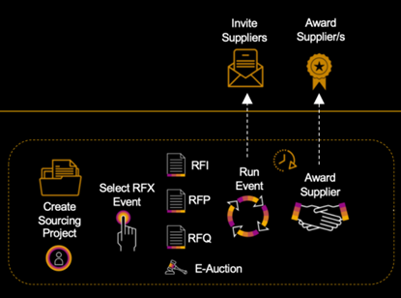
Business Overview
Name: Mr. John Smith
Picture
Background:
Job Title / Role:
45 Years old
20 Yrs of Automobile Domain Expertise
Sourcing Manager
Business Challenge
Business Process
I am a Sourcing Manager at XYZ Corp, A car manufacturing company. For the upcoming financial year 2022, we have a corporate strategy on cost savings for the procurement of raw materials. Sourcing activities are currently manual and this needs to be carried out for more than 5000 raw materials. I have more than 25000 quotations to review and award by next two weeks. An “Intelligent Supplier Evaluation & Selection” to predict the supplier characteristics from the past experiences and optimize supplier selection process is desirable.

Slide 4
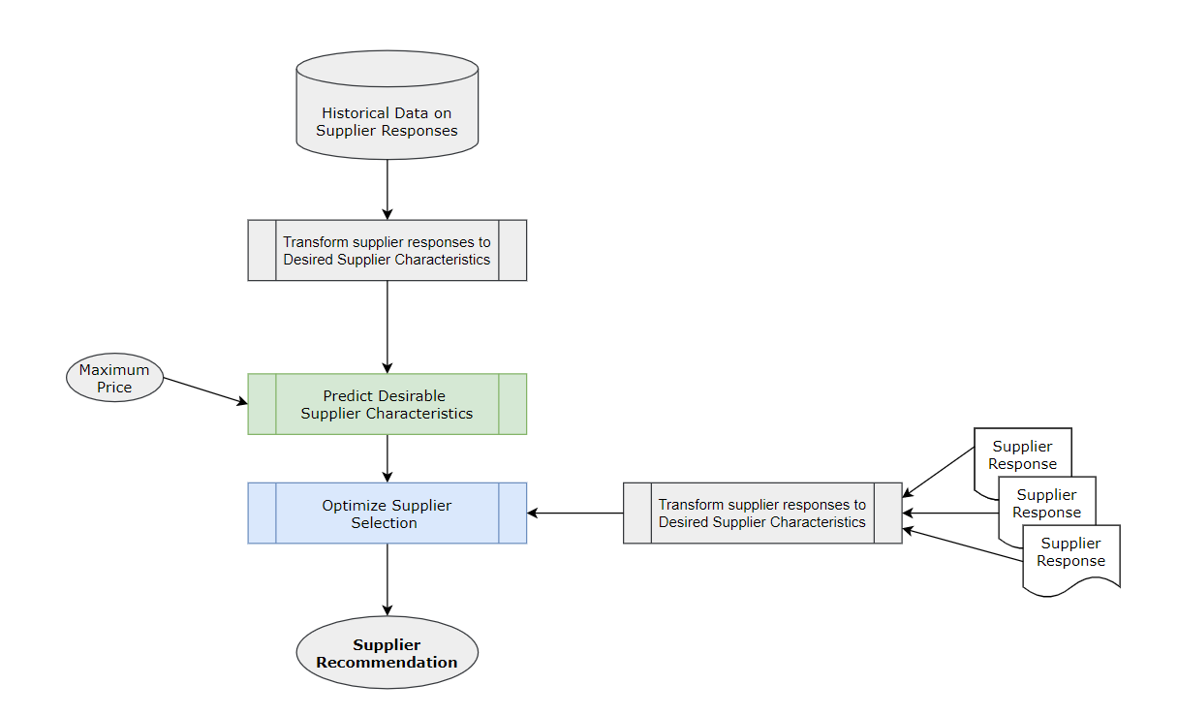
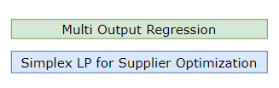

Intelligent Supplier Evaluation & Selection Process
This solution is feasible. I have lots of information on Delivery timelines, Locations, Questionnaires, Quoted prices etc. from the Past. I can easily convert them into desired supplier characteristics. This is just one time effort as desirable characteristics does not change so frequently.
Let me try out this approach for one of the critical raw material – 17inch Tyre
Demo

Slide 5
Customer Testimonial
Solution is suitable for many Supplier Characteristics in Automobile Industry :
Cost, Quality, Delivery, Service,
Supplier’s Profile, Reliability, Environment, Responsiveness, Logistical Performance,
Commercial Plans & Structure, Production, Facility and Technology, Quality of Relationship with Vendor, Risk Factor,
Technology and Capability ,Collaboration, Supplier’s Willingness, R&D etc.
Wow!!! This solution is perfect for sourcing. I was able to award the suppliers for all raw material requirements on time. All the cost savings measurements are met as part of corporate Strategy. Let me give testimonial Immediately…
After two weeks ….
“Intelligent Supplier Evaluation & Selection Process” is desirable, feasible, and scalable solution. I have the flexibility to map supplier responses to supplier characteristics of my choice to gain competitive advantage. It helps me eliminate human errors and move towards Intelligent sourcing.
- Mr. John Smith, Sourcing Manager, ABC Corp.

Slide 6
Thank you.

